Slide 1


Single Image Reflection Separation via Dual-Stream Interactive Transformers
Qiming Hu, Hainuo Wang and Xiaojie Guo
Tianjin University
Speaker: Qiming Hu

Slide 2
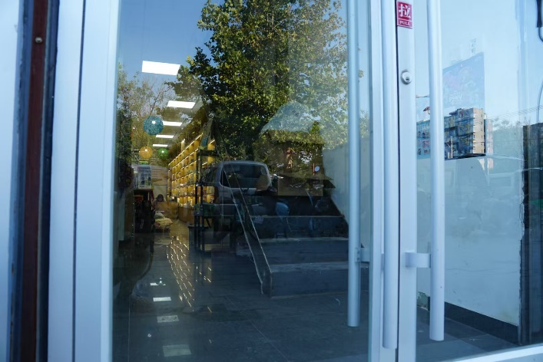
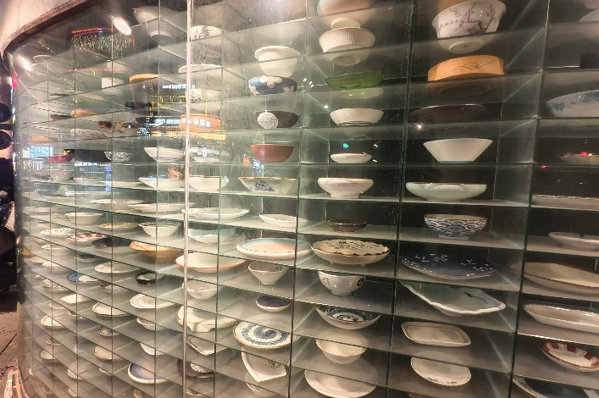
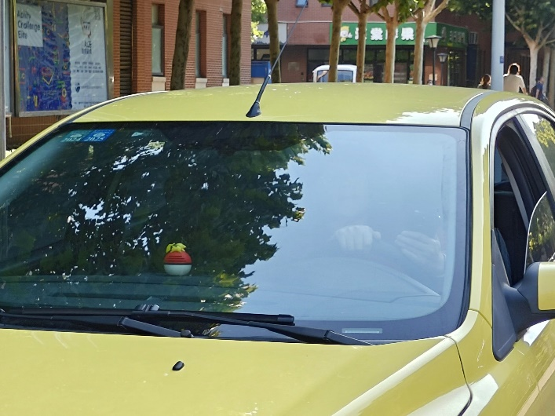

Reflection Superimposition
Real data collection setup*
Typical Reflective Scenarios
* Xuaner Cecilia Zhang, Ren Ng, and Qifeng Chen. Single image reflection separation with perceptual losses. In CVPR, pages 4786–4794, 2018.
Notes:
To start with, let’s talk about the phenomenon of reflection superimposition, which often occurs when taking pictures through transparent mediums such as glass and water.

Slide 3
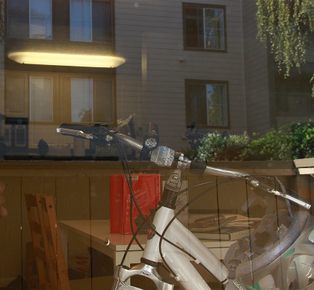
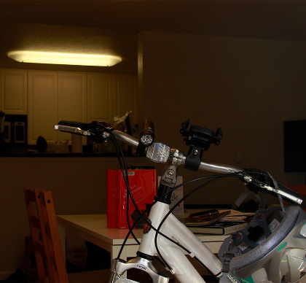
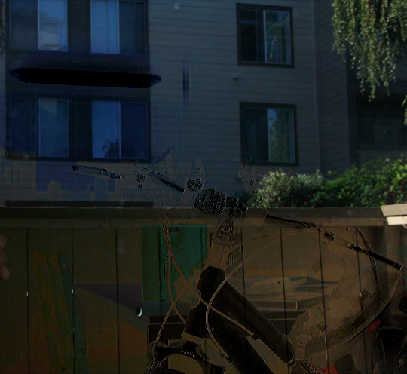
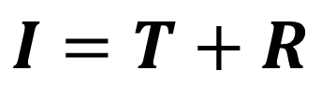
Single Image Reflection Separation (SIRS)
$$I=T+R$$
Real data collection setup*
Blended Image (I)
Transmission Layer (T)
Reflection Layer (R)
* Xuaner Cecilia Zhang, Ren Ng, and Qifeng Chen. Single image reflection separation with perceptual losses. In CVPR, pages 4786–4794, 2018.
Notes:
The prior works commonly assume that the blended image of the transmission and reflection layers is composed of their additive combination.

Slide 4
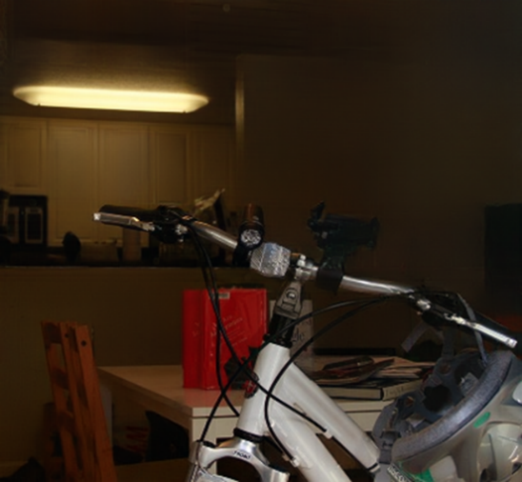
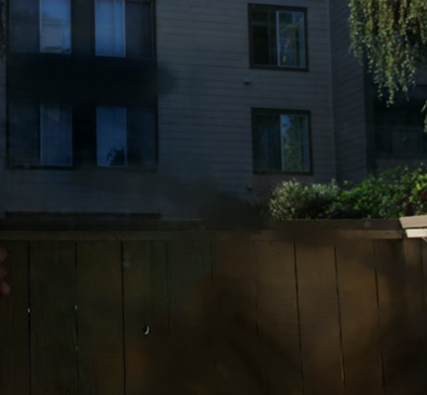
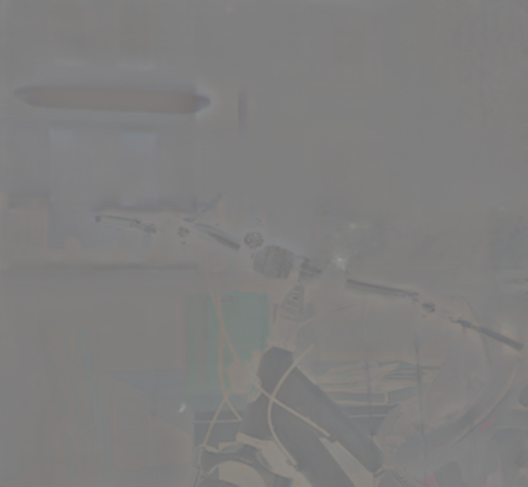
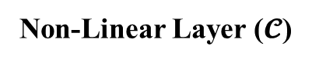

Single Image Reflection Separation (SIRS)
$$I=T+R$$
$$+ 𝓒(T,R)$$
Real data collection setup*
Transmission Layer (T)
Reflection Layer (R)
Non-Linear Layer ($𝓒$)
* Hu, Qiming, and Xiaojie Guo. Single image reflection separation via component synergy. In ICCV, 2023.
Notes:
However, based on the observation of our previous work, the linear model cannot be assured due to the non-linear operations in the camera ISP. Therefore, an extra learnable non-linear term is introduced in the physical model, which is adopted in this work.

Slide 5
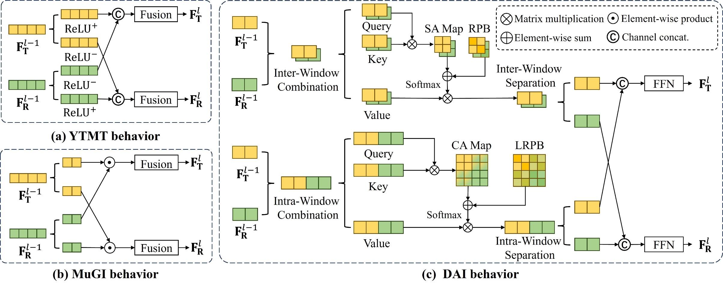
Dual-Stream Interactive Models for SIRS
Transmission Stream
Hu, Qiming, and Xiaojie Guo. Trash or treasure? an interactive dual-stream strategy for single image reflection separation. In NeurIPS 2021.
Notes:
Now, let’s review previous dual-stream interactive models for SIRS. This is the illustration of the YTMT behavior. The upper branch is the transmission stream.

Slide 6
Dual-Stream Interactive Models for SIRS
Reflection Stream
Hu, Qiming, and Xiaojie Guo. Trash or treasure? an interactive dual-stream strategy for single image reflection separation. In NeurIPS 2021.
Notes:
And the lower branch is the reflection stream.

Slide 7
Dual-Stream Interactive Models for SIRS
Interactions
* Hu, Qiming, and Xiaojie Guo. Single image reflection separation via component synergy. In ICCV, 2023.
Notes:
The MuGI mechanism proposed in DSRNet shares the similar behavior.
Though being more effective by introducing the cross-stream interactions,

Slide 8
Dual-Stream Interactive Models for SIRS
Without double-checking
Interactions
* Hu, Qiming, and Xiaojie Guo. Single image reflection separation via component synergy. In ICCV, 2023.
Notes:
The interactions in these two methods lack double-checking when transfers the cross-stream signals. This can cause problems, since we cannot assure that the transferred information are always needed by the other branch.

Slide 9
Our Dual-Attention Interaction Design
Notes:
Therefore, we propose the dual-attention interaction mechanism, namely DAI. So, how does it double-check the transferred information? Let’s take a closer look at the dual-stream cross-attention map.

Slide 10
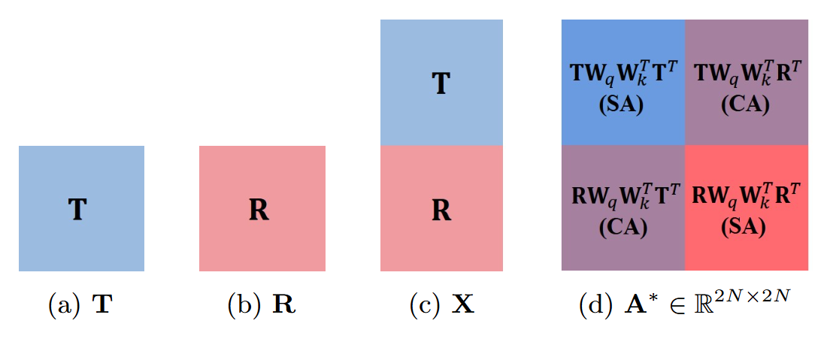
Our Dual-Attention Interaction Design
“double-checking”: comparison between SA and CA
Notes:
Here it is. The attention map of our proposed dual-stream cross-attention is a combination of four parts, including the self-attention and cross-attention of the two layers

Slide 11
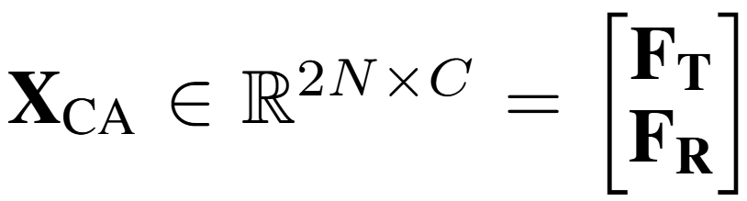
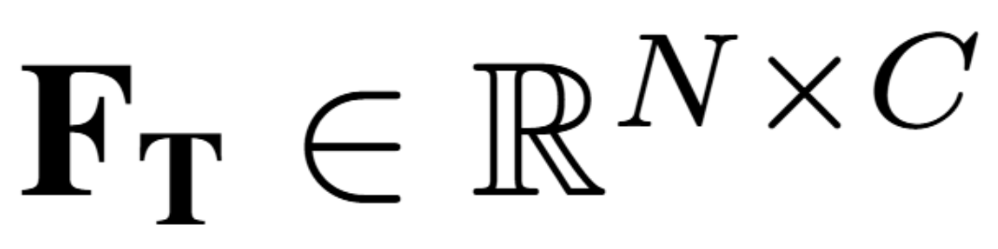
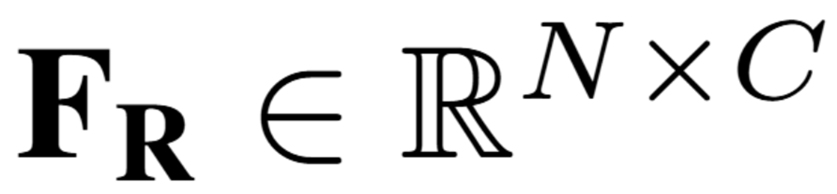
Dual-Stream Cross-Attention
Dual-stream feature inputs:
Notes:
Formally, given the dual-stream feature inputs, we first concatenate them along the token dim, getting double number of tokens.

Slide 12
Dual-Stream Cross-Attention
Dual-stream feature inputs:
Vectors for the attention:
Notes:
Then, we do the linear projections.

Slide 13
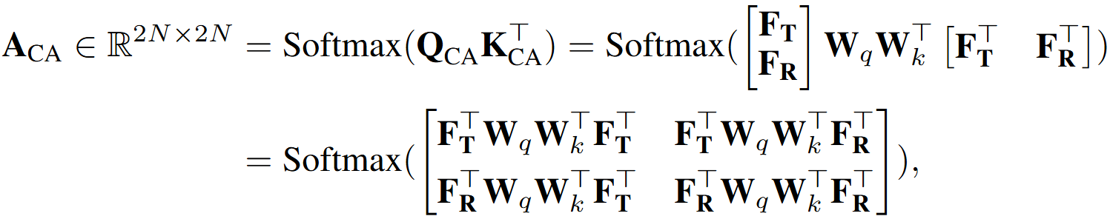
Dual-Stream Cross-Attention
Dual-stream feature inputs:
Vectors for the attention:
Dual-Stream Cross-Attention Map:
Notes:
Thereafter, we can obtain the attention map of DS-CA by the matrix multiplication. As we can see, the attention map is divided into four parts.

Slide 14
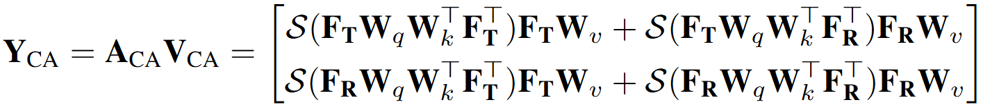
Our Dual-Attention Interaction Design
Dual-Stream Cross-Attention Output:
Notes:
Further, we apply the attention on values, obtaining the output Y_CA.

Slide 15
Our Dual-Attention Interaction Design
Dual-Stream Cross-Attention Output:
Denote:
Notes:
To make it clearer, we do the following replacement,

Slide 16
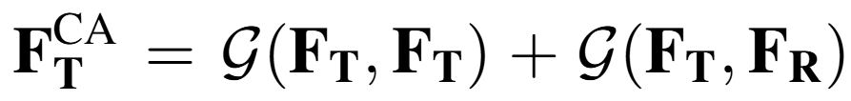
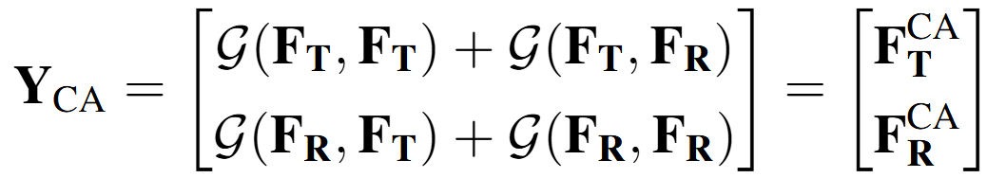
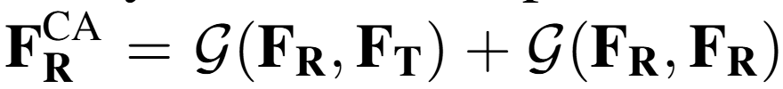
Our Dual-Attention Interaction Design
Dual-Stream Cross-Attention Output:
Denote:
We can derive the simplified version:
Notes:
, deriving the simplified expression, which can be split into the outputs of transmission and reflection layers, respectively. Each of them are the synergy of both intra-layer Self-Attention and inter-layer Cross-Attention.

Slide 17
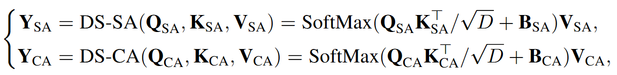

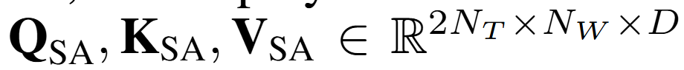
Our Dual-Attention Interaction Design
Notes:
To strengthen the correlation of intra-layer signals, we setup a dual-stream self-attention in parallel with the DS-CA.

Slide 18
Our Dual-Attention Interaction Design
Token Number
Window Size
Notes:
To reduce the computation burden, we employ a window-based attention mechanism for our dual-attention design.
Here, N_T denotes the token number and N_w represents the window size.

Slide 19
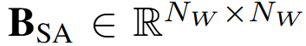
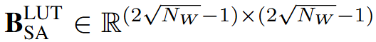
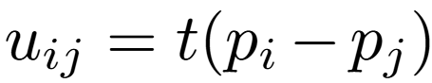
Our Dual-Attention Interaction Design
Relative Position Bias:
obtained by indexing a learnable lookup table: through
Notes:
Note that we employ the relative position bias for the window-based attention, which is obtained by indexing a learnable lookup table through the mapping of the distance of two 2-d points in a window for dual-stream self-attention.

Slide 20
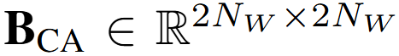
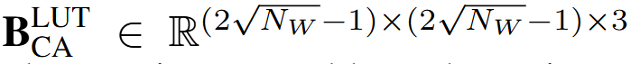
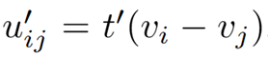
Our Dual-Attention Interaction Design
Relative Position Bias:
obtained by indexing a learnable lookup table: through
Layered Relative Position Bias:
The learnable lookup table is extended as: through
Notes:
As for the dual-stream cross-attention, we propose the layered relative position bias, which enjoys an extended learnable lookup table, indexed by the mapped distance of two 3-d points in a two-layer window.

Slide 21
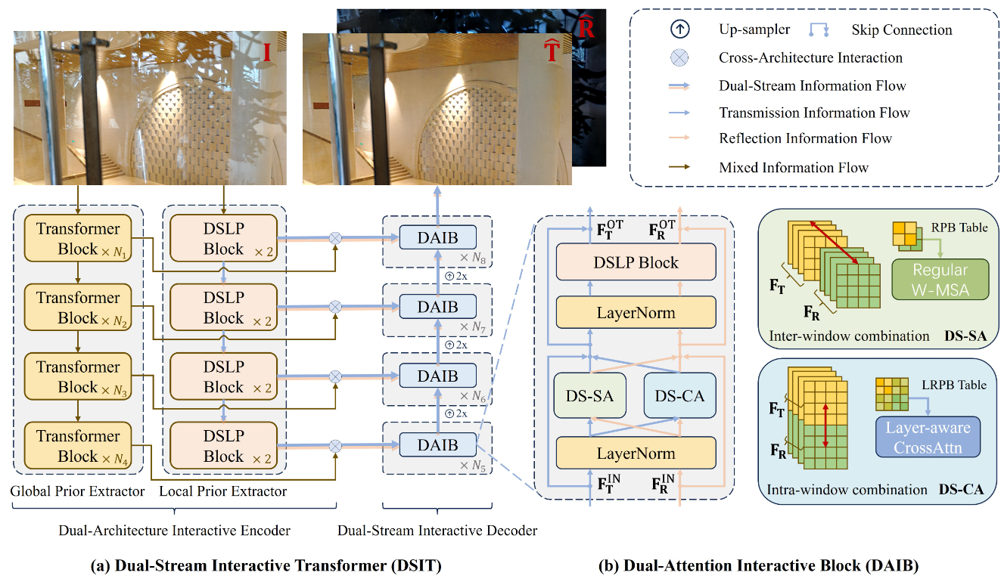
Overview of Our Architecture
Notes:
We make use of our proposed DAI mechanism to constitute our dual-attention interactive block, which is further used to build the DSIT.

Slide 22
Overview of Our Architecture
Notes:
Moreover, we design a Dual-Architecture Interactive Encoder, consisting of both global and local prior extractors.
The extracted dual architecture features interact through our proposed DAIB.
The DSLP Block is implemented by the MuGI Block

Slide 23
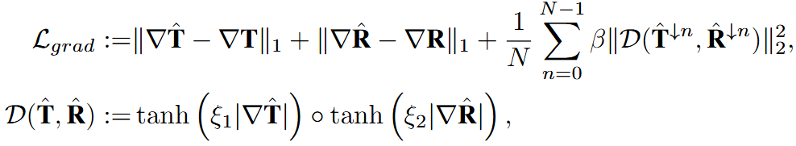
Loss functions
Pixel Reconstruction Loss:
Layer Reconstruction
Superimposition Reconstruction
Gradient Reconstruction Loss:
Layer Gradient Reconstruction
Gradient Exclusion
Notes:
Our loss functions contain pixel reconstruction loss, gradient reconstruction loss
Our loss function contains the pixel reconstruction loss, the first two terms keep the fidelity of the estimation to the ground-truth, the third loss term ensures the predictions can reconstruct the superimposition scenario by introducing a learnable residual term.
We employ the gradient reconstruction loss, consisting a layer gradient reconstruction part and a gradient exclusion part, implemented by the element-wise multiplication of the multi-scale gradients of the two layers.

Slide 24
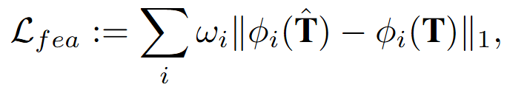
Loss functions
Feature Reconstruction Loss:
Perceptual Fidelity of the Transmission
Overall Loss:
Notes:
And the feature reconstruction loss
The overall objective function is their linear combination.
The third loss function is the feature reconstruction loss to encourage the perceptual fidelity of the transmission layer, utilizing a pretrained VGGNet.
Our overall objective function is the linear combination of aforementioned loss functions.

Slide 25
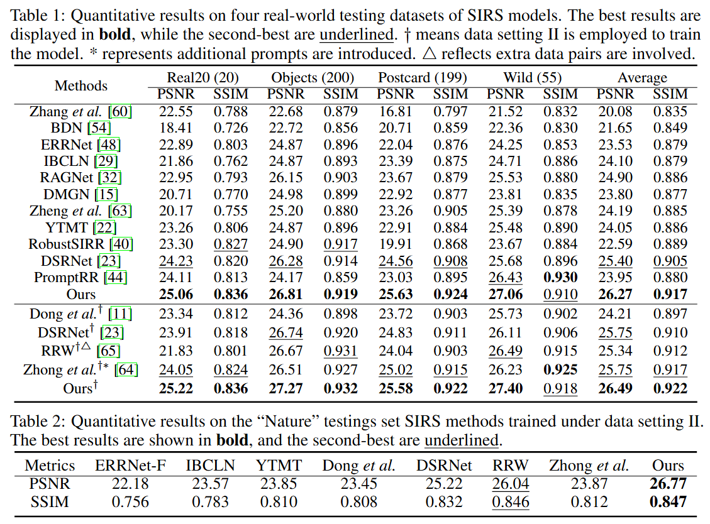
Experiments – Quantitative Comparisons
Notes:
OK, let’s move to the quantitative comparisons, which are conducted on five real-world testing datasets. As can be seen, our method shows significant overall superiority /suːˌpɪriˈɔːrəti/ over the alternatives on these datasets.
, including real20, three subsets of SIR square dataset and the nature testing dataset.

Slide 26
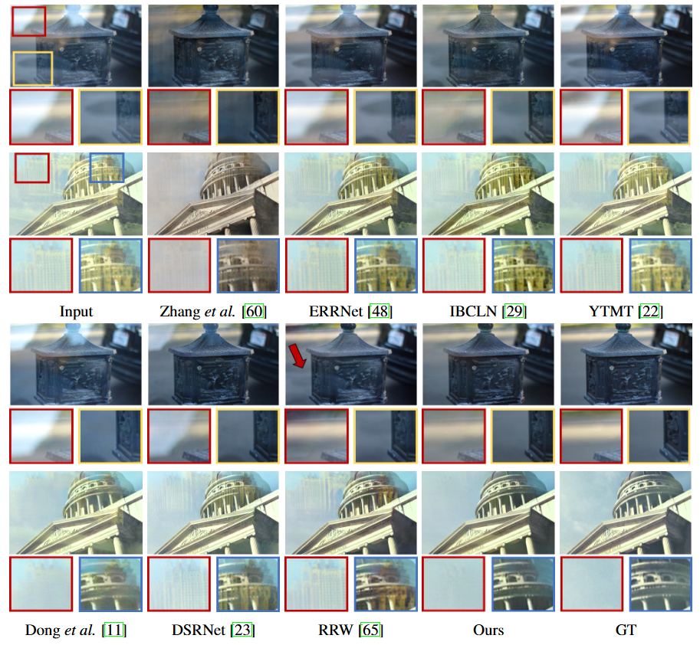
Experiments – Qualitative Comparison of the Transmission Layers
Notes:
This is the visual comparison between the results of competitors and ours. As can be seen, we present clearer transmission layers with minimum residual reflections.

Slide 27
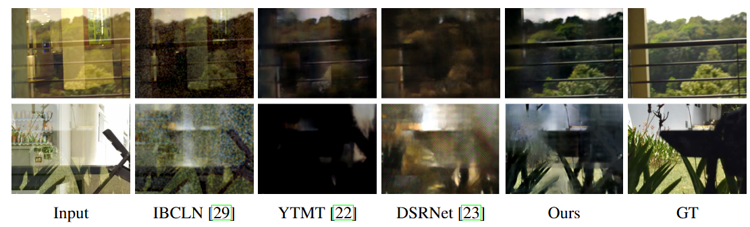
Experiments – Qualitative Comparison of the Reflection Layers
Notes:
Moreover, with respect to the visual quality of the reconstructed reflection layers, our method provides MUCH MORE reasonable results compared with the alternatives.

Slide 28
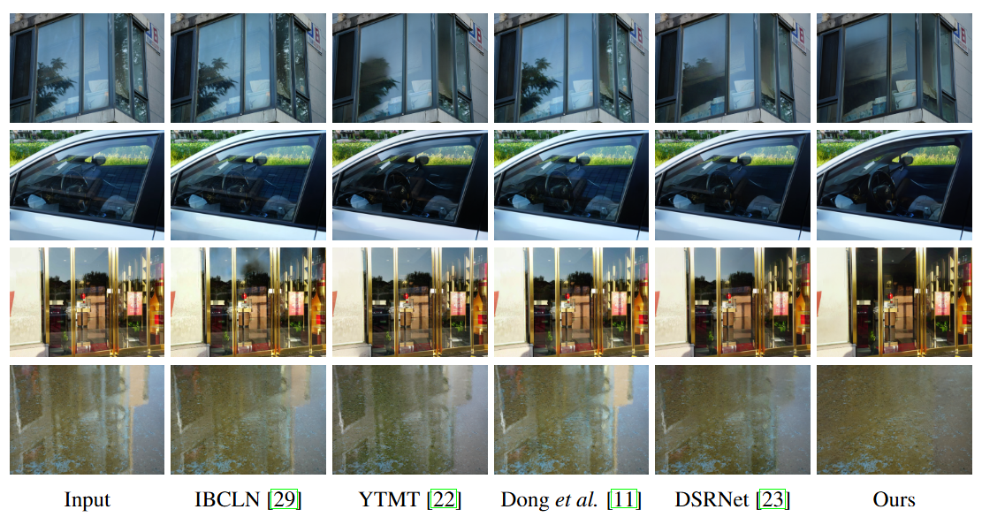
Experiments – Qualitative Comparison in the Wild
Notes:
In addition, we present the comparison in the wild beyond the limited conditions in standard benchmarks. The striking better performance of our approach underscores its robust generalizability and practical applicability.
Unlike standard benchmarks that employ artificial glass plates, these cases utilize real-world reflective surfaces, including reflections from accumulated water—conditions entirely absent from the training set.

Slide 29
Thanks !
Notes:
Thank you for listening.

